Slide 1
Raspberry Pi
Mohammed Elbadry

Slide 2
Overview
Raspberry Pi
How to install
How it works
How to connect simple modules (e.g., LED)
How to connect sensors (e.g., inertial sensor MPU 6050)
What is MPU 6050
What is accelerometer
What is gyroscope
Cloud
How to connect pi to cloud
How MQTT works
How to achieve bidirectional communication

Slide 3
Hardware Needed
Raspberry Pi
Inertial sensor module MPU-6050
LED
Resistor - 330 ohm
Breadboard
Jumper wires (get 8 female-male and 2 male-male)
Please go to hardware.mlh.io to get these stuffs

Slide 4
How to Install Raspbian
Download Raspbian
https://www.raspberrypi.org/downloads/
Use Etcher to install Raspbian to SD card
https://www.balena.io/etcher/

Slide 5
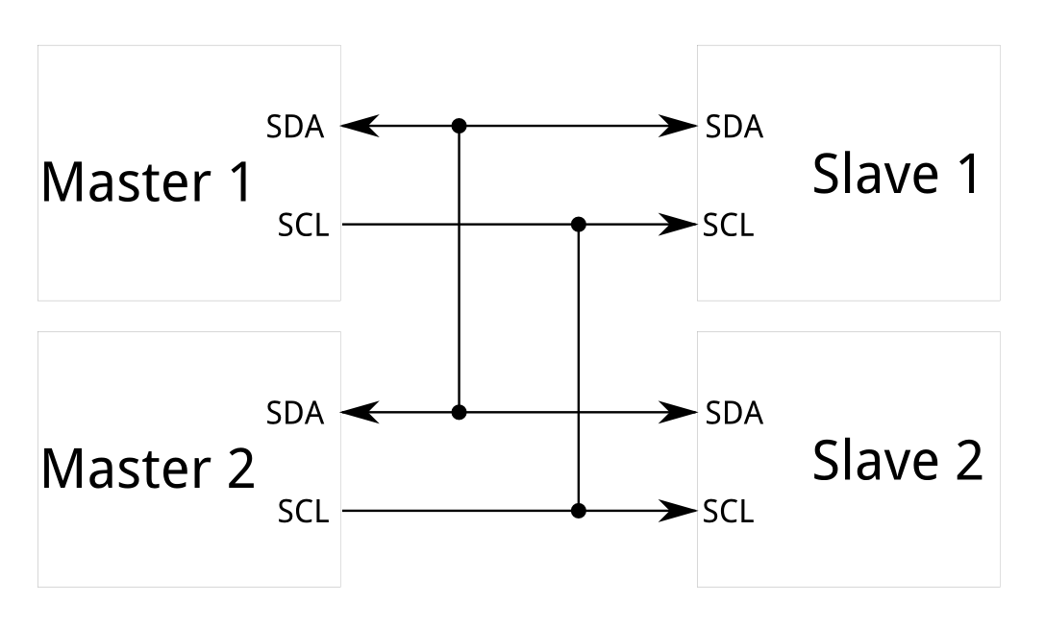
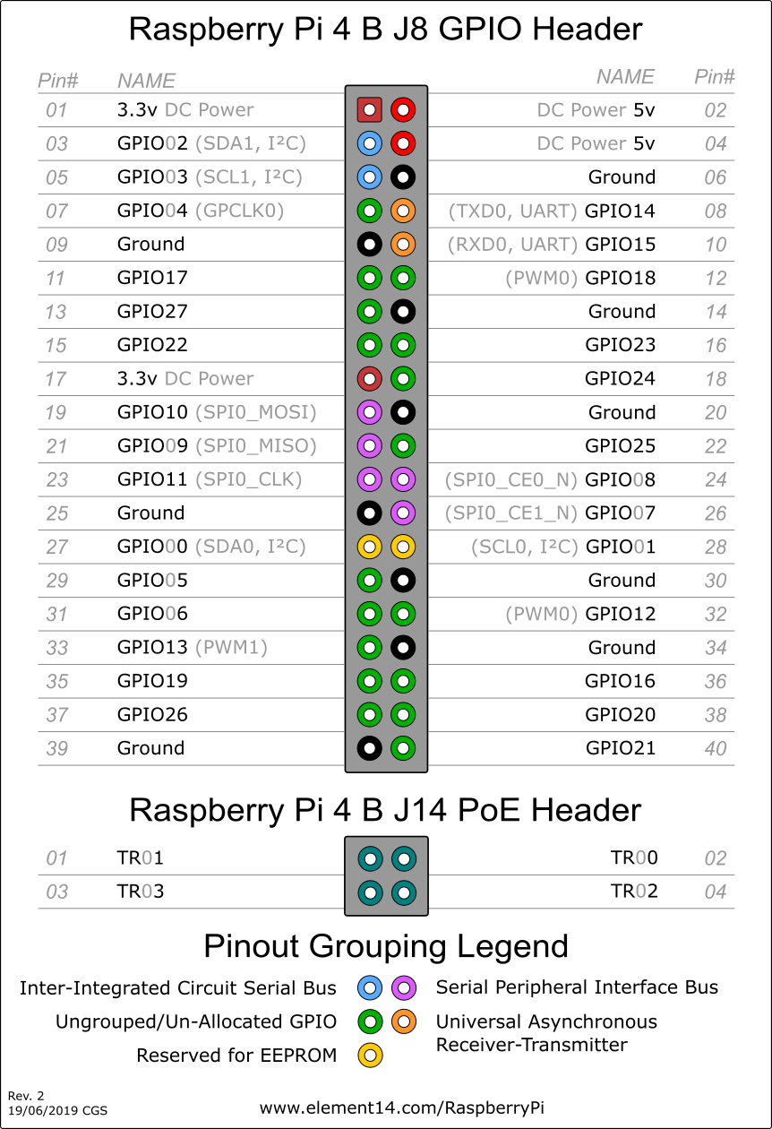
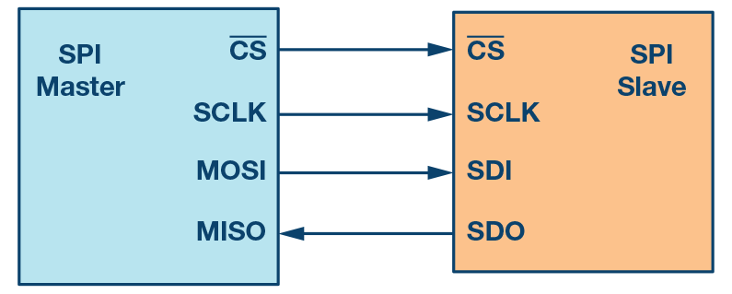
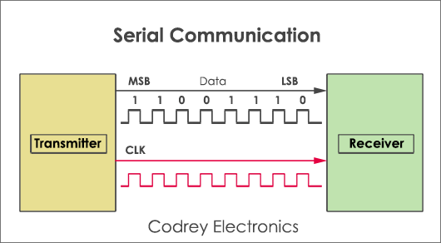
How to connect simple modules
Raspberry pi offers GPIO pins:
I2C
SPI
Serial
General GPIO

Slide 6
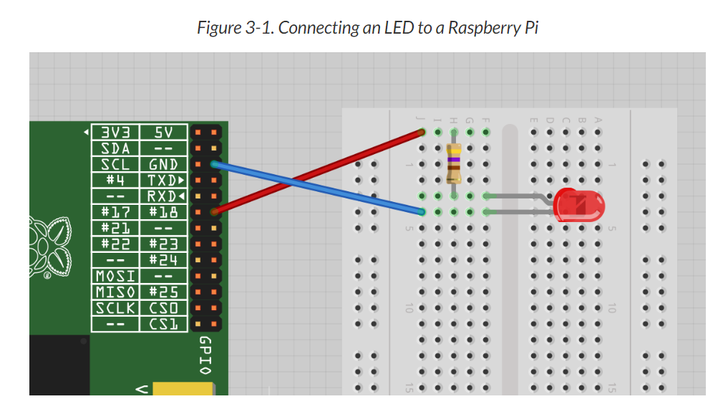
Connect Raspberry pi to LED
sudo python
import RPi.GPIO as GPIO
GPIO.setmode(GPIO.BCM)
GPIO.setup(18, GPIO.OUT)
GPIO.output(18, True)
GPIO.output(18, False)
http://razzpisampler.oreilly.com/ch03.html

Slide 7
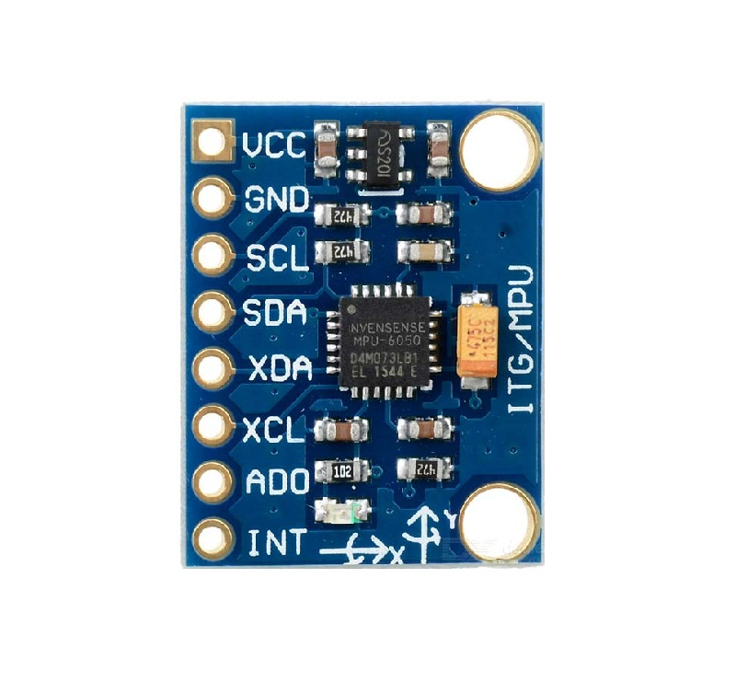
MPU-6050
I2c interface
VCC is power
GND is ground
Datasheet
https://www.invensense.com/wp-content/uploads/2015/02/MPU-6000-Datasheet1.pdf

Slide 8
MPU-6050
Accelerometer
A device that measures proper acceleration. Proper acceleration, being the acceleration of a body in its own instantaneous rest frame, is not the same as coordinate acceleration.
Gyroscope
Device used for measuring or maintaining orientation and angular velocity. It is a spinning wheel or disc in which the axis of rotation is free to assume any orientation by itself.

Slide 9
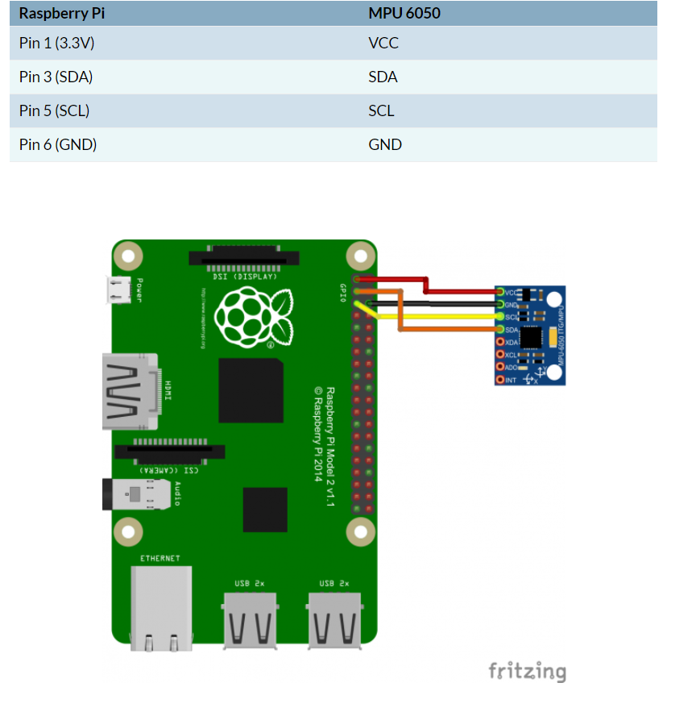
Connecting MPU-6050
Connect Raspberry pi to sensor following diagram on the right.
https://github.com/CryptoMatrix/hackcewit2020.git
https://www.electronicwings.com/raspberry-pi/mpu6050-accelerometergyroscope-interfacing-with-raspberry-pi

Slide 10
Reading Measurements
Enable i2c interface
Add following lines per raspberry instructions to /etc/modules file:
i2c-bcm2708
i2c-dev
sudo apt-get install i2c-tools python-smbus
sudo i2cdetect -y 1

Slide 11
Run Python Sample
Let’s run Python code sample and go over how it works!
Code reads gyroscope measurements, accelerometer and prints it out
Challenge: Try obtaining temperature reading

Slide 12
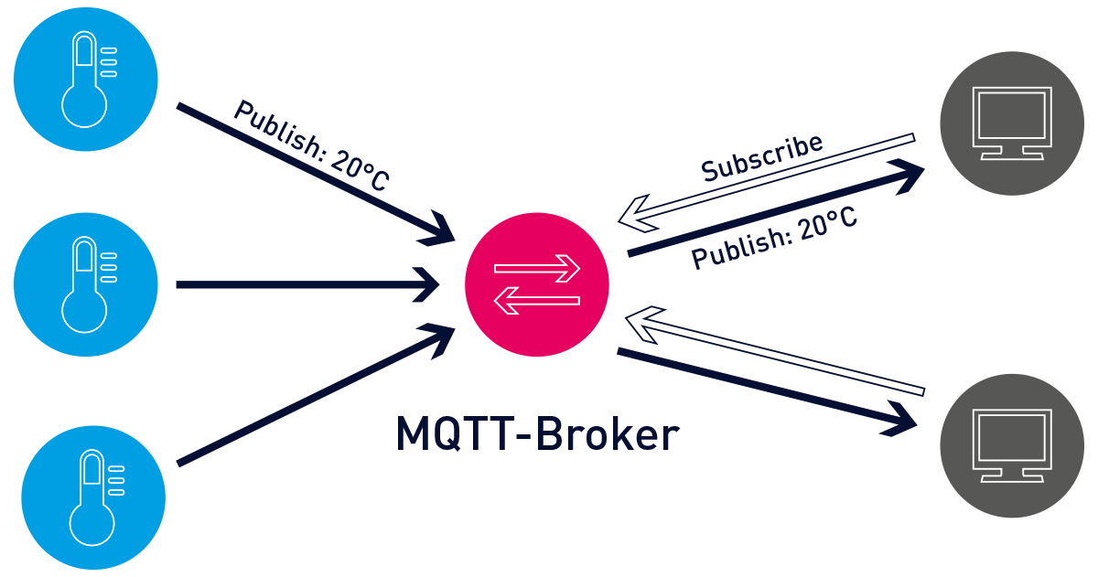
MQTT
pub/sub System

Slide 13
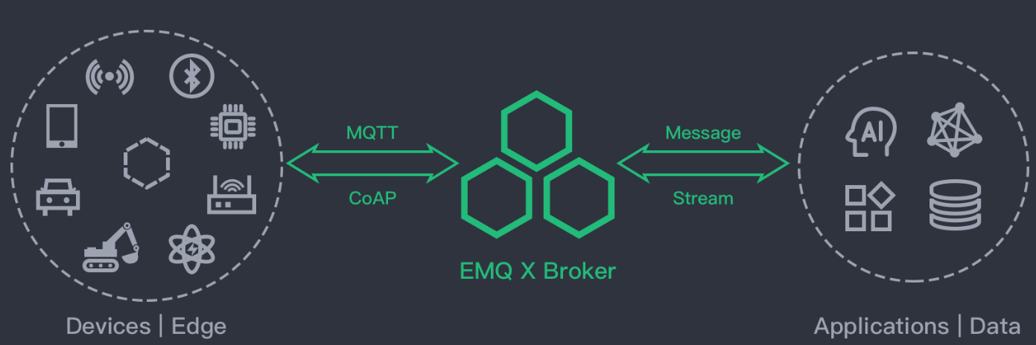
Cloud
EMQX
https://www.emqx.io/
54.225.10.144

Slide 14
MQTT Python Code
Run pip install paho-mqtt
Next Step after connecting:
Use mqtt.fx client to send data back to your device through cloud

Slide 15
Thank You

